Slide 1
PHYS 7703: Planetary Science
Topic 2: The Earth System
Lecture 5: Atmosphere 4
Disclaimer: Much of the material contained within these lectures is subject to
copyright and is not for distribution or use outside of this course.

Slide 2
Outline of Earth Study
Lecture 1: Interior and Surface.
Lecture 2: Atmosphere Part 1.
Lecture 3: Atmosphere Part 2.
Lecture 4: Atmosphere Part 3.
Lecture 5: Atmosphere Part 4.
Lecture 6: The Moon.
Lecture 7: Atmospheric Evolution Part 1.
Lecture 8: Atmospheric Evolution Part 2.
Lecture 9: Atmospheric Evolution Part 3.

Slide 3
Why do we care about hydrogen escape?
Most H comes initially from H₂O. Thus, when H escapes, O is left behind
⇒ terrestrial planets become more oxidized with time
H₂ (and/or CH₄) concentration in the early atmosphere is determined by balancing volcanic outgassing of reduced gases with escape of hydrogen to space

Slide 4
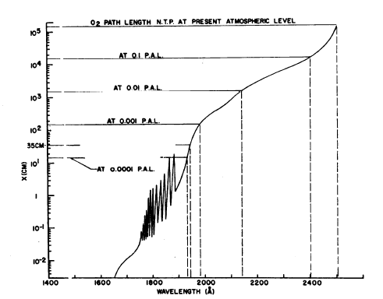
Prebiotic O₂ levels—historical perspective
Berkner and Marshall (1964, 1965, 1966, 1967) tried to estimate prebiotic O₂ concentrations
  They recognized that the net source of O₂ was photolysis of H₂O followed by escape of H to space
  These authors assumed that O₂ would build up until it shielded H₂O from photolysis

Slide 5
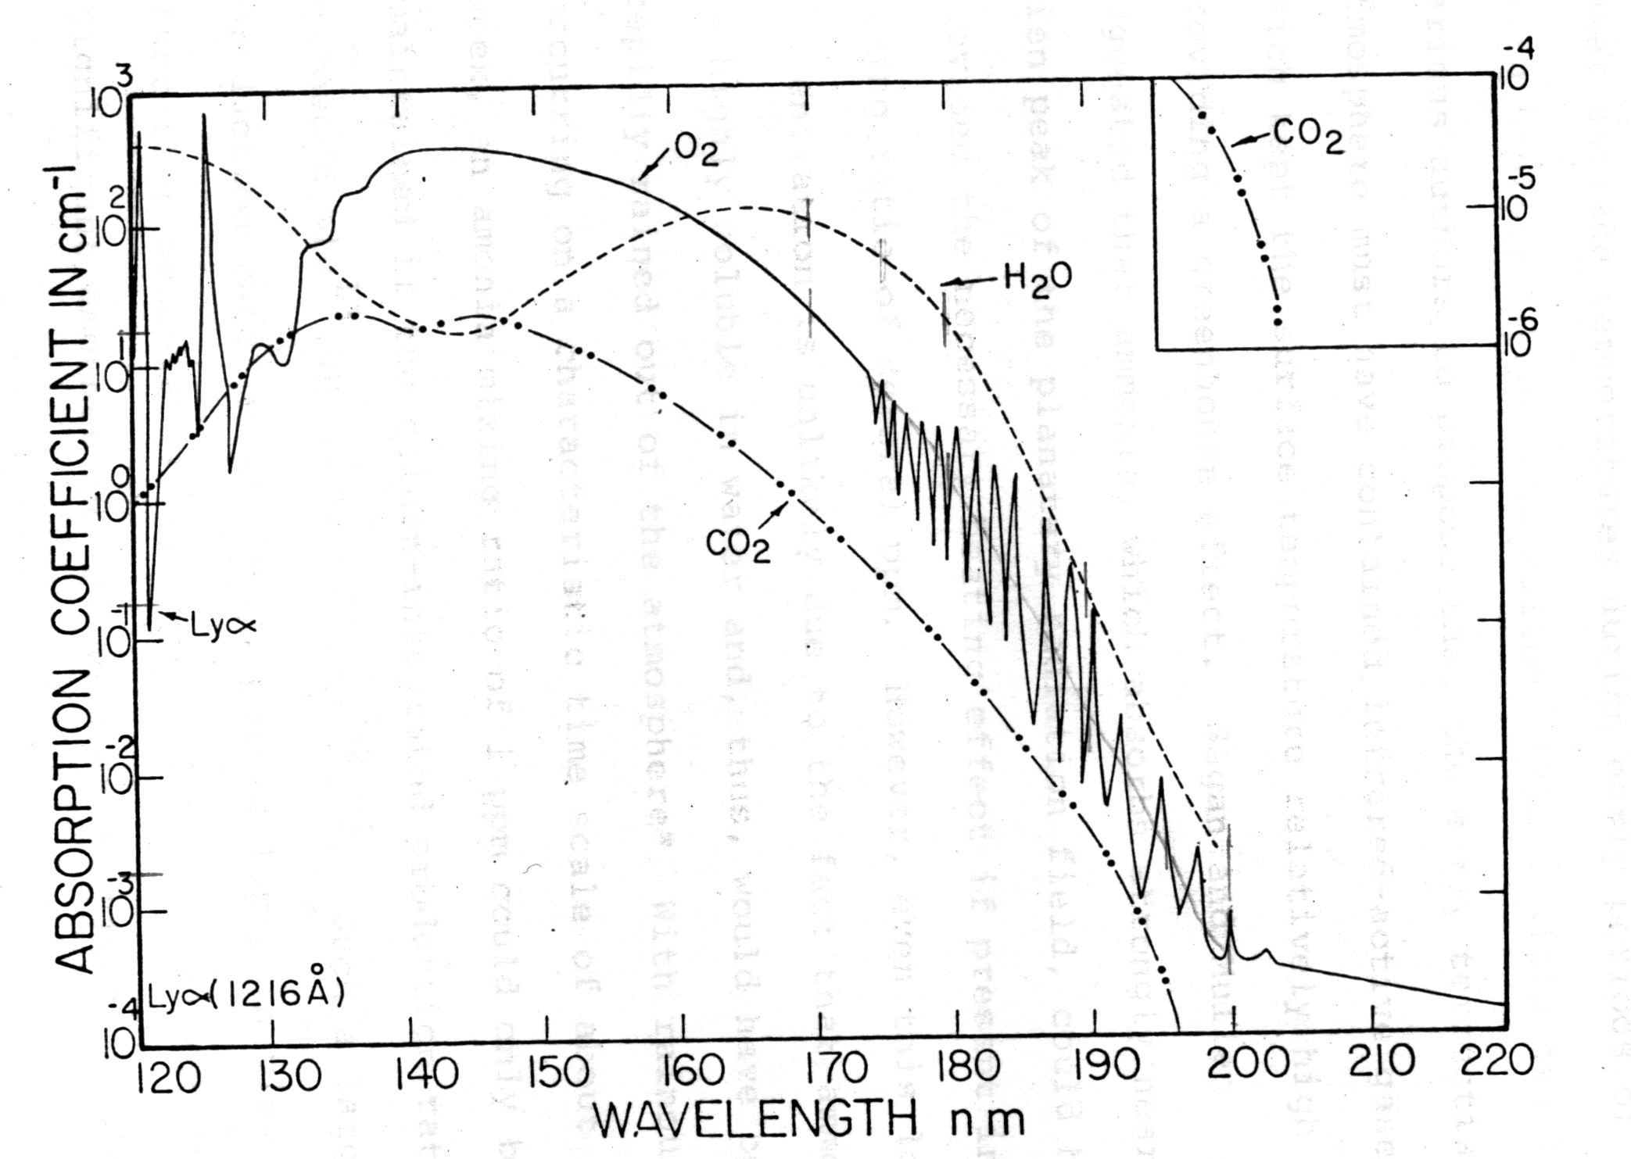
UV absorption coefficients of various gases
S-R continuum
Schumann
-Runge bands
Herzburg
continuum
Source: J.F. Kasting, Ph.D. thesis, Univ. of Michigan, 1979

Slide 6
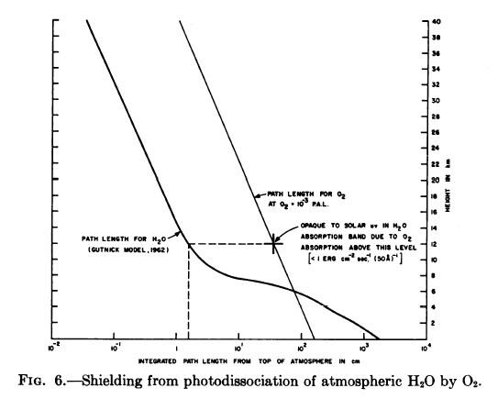

Berkner and Marshall’s model
Resulting O₂
mixing ratio is of
the order of 10⁻³
to 10⁻⁴ PAL
(times the Present
Atmospheric Level)

Slide 7
Brinkman’s model
Brinkman (Planet. Space Sci. 19, 791-794, 1971) predicted abiotic O₂ concentrations as high as 0.27 PAL
Sinks for O₂
  He included a sink due to crustal oxidation, but he neglected volcanic outgassing of reduced species (e.g., H₂, CO)
Source of O₂
  He assumed that precisely 1/10th of the H atoms produced by H₂O photolysis escaped to space. This fraction is much too high..

Slide 8
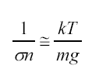
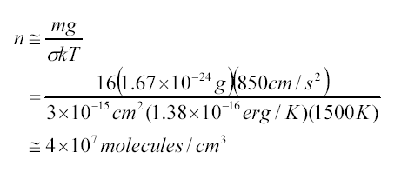
Hydrogen escape
Hydrogen escape can be limited either at the exobase (~500 km altitude) or at the homopause (~100 km altitude)
Exobase—the altitude at which the atmosphere becomes collisionless
  An exobase may not exist in a hydrogen-dominated upper atmosphere ⇒ get hydrodynamic escape
  In any case, the factor limiting H escape in this case is energy (from solar EUV heating)
Mean free path
= local scale height
= molecular
collision
cross section

Slide 9
Hydrogen escape (cont.)
Homopause—the altitude at which molecular diffusion replaces “eddy diffusion” as the dominant vertical transport mechanism
  The flux of hydrogen through the homopause is limited by diffusion
Homopause
Exobase
100 km
500 km

Slide 10
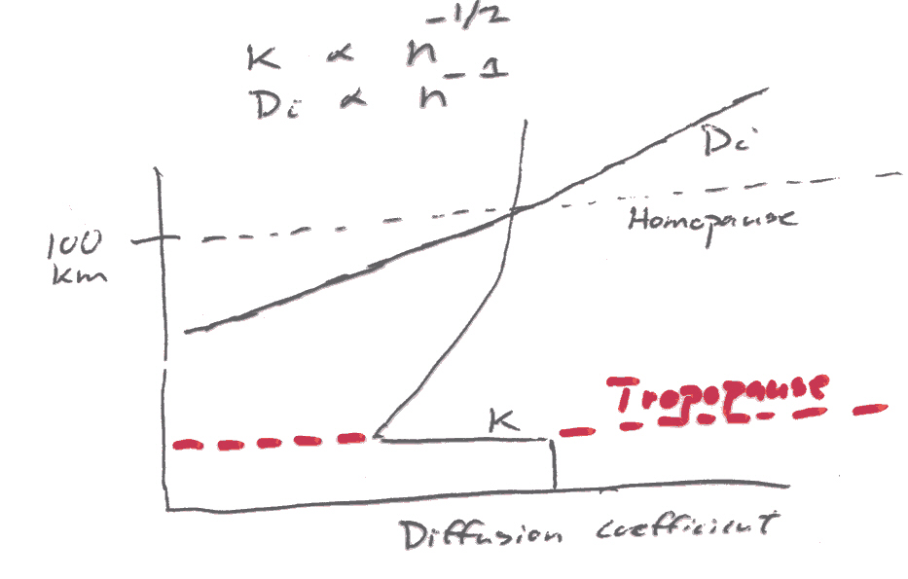
Hydrogen escape (cont.)
Molecular
diffusion
Eddy
diffusion
(log
scale)

Slide 11
Exosphere
(Collisionless)
H
Exobase
500
Heterosphere
(Molecular diffusion—light gases separate
from heavier ones)
Altitude (km)
Homopause
H or H₂
100
Homosphere
(Eddy diffusion—gases are well-mixed)
0
Surface

Slide 12
Hydrogen escape from the exobase
Earth’s upper atmosphere is rich in O₂ (a good EUV absorber) and poor in CO₂ (a good IR radiator) ⇒ the exosphere is hot
  T∞ ≅ 700 K (solar min)
  ≅ 1200 K (solar max)
Furthermore, H₂ is broken apart into H atoms by reaction with hot O atoms
H₂ + O → H + OH
OH + O → O₂ + H
Escape of light H atoms is therefore relatively easy

Slide 13
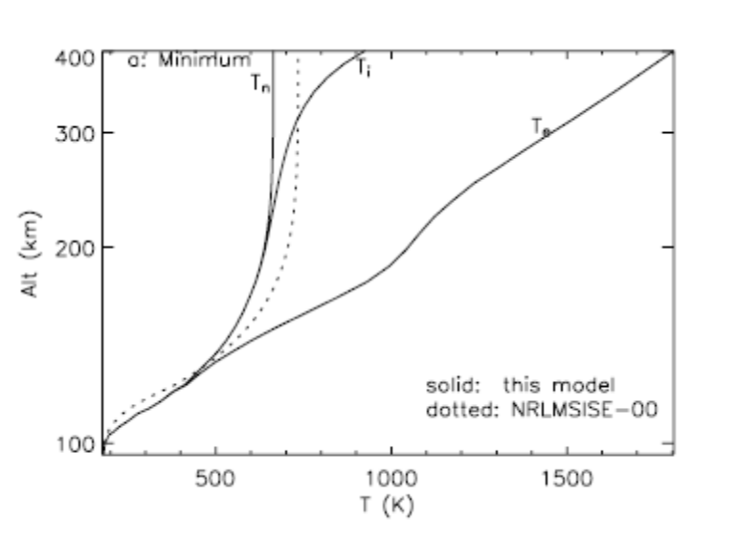
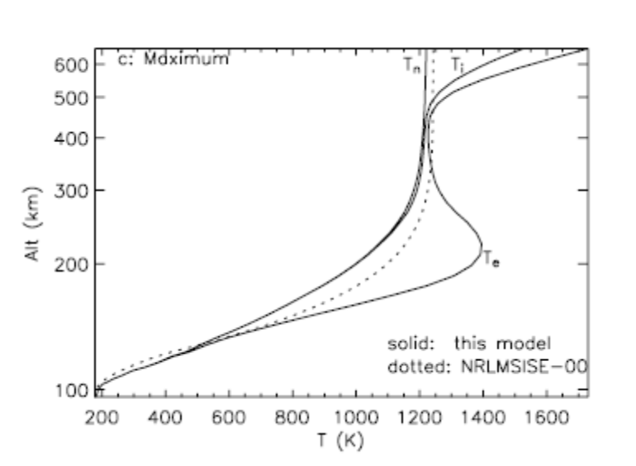
Thermospheric temperature profiles for Earth
Solar minimum
Solar maximum
T_{n} = neutral temperature
T_{i} = ion temperature
T_{e} = electron temperature
F. Tian et al., JGR, in press

Slide 14
Hydrogen escape from the exobase
For Earth, there are 3 important H escape mechanisms:
  Jeans escape: thermal escape from the high-energy tail of the Maxwellian velocity distribution
  Charge exchange with hot H⁺ ions in the magnetosphere
  The polar wind

Slide 15
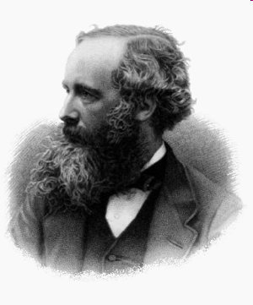
Kinetic theory of gases
James Clerk Maxwell (1831-1879)
  “(The work of Maxwell) ... the most profound and the most fruitful that physics has experienced since the time of Newton.”
  —Albert Einstein, The Sunday Post
Source: Wikkipedia

Slide 16
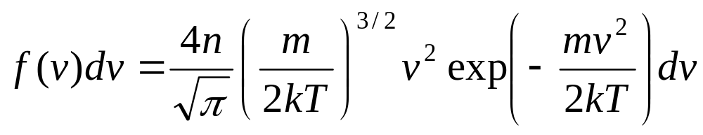
Maxwellian velocity distribution
The number of molecules with speeds between v and v + dv is given by
Here
k = Boltzmann’s constant, 1.38×10⁻²³ J/K
m = molecular mass
T = temperature (K)

Slide 17
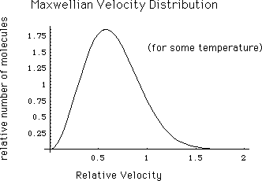
Maxwellian velocity distribution

Slide 18
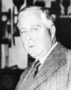
Kinetic theory of gases
Sir James Jeans (1877-1946)
  Wrote: The Dynamical Theory of Gases (1904)
  Figured out large chunks of what we now study in physics classes…
Source: Wikkipedia

Slide 19
Jeans (thermal) escape
H atoms with velocities
exceeding the escape
velocity can be lost
v_{esc}

Slide 20
Escape velocity
In order to escape, the kinetic energy of an escaping molecule must exceed its gravitational potential energy and it must be headed upwards and not suffer any collisions that would slow it down
Who can do this mathematically?

Slide 21
Escape velocity
½ mv_{e}² = GMm/r
(K.E.) (P.E.)
v_{e} = (2GM/r)^{1/2}
= 10.8 km/s (at 500 km altitude)
m = mass of atom (1.67×10⁻²⁷ kg for H)
M = mass of the Earth (5.98×10²⁴ kg)
G = universal gravitational constant (6.67×10⁻¹¹ N m²/kg²)
r = radial distance to the exobase (6.871×10⁶ m)

Slide 22
Most probable velocity
H atoms with velocities
exceeding the escape
velocity can be lost
v_{s}
v_{esc}

Slide 23
Root mean square velocity
Energy: ½ kT per degree of freedom
Translational energy: 3 degrees of freedom
⇒ KE = 3/2 kT
½ mv² = 3/2 kT
v_{rms} = (3kT/m)^{1/2}

Slide 24
Most probable velocity
Most probable velocity: v_{s} = (2kT/m)^{1/2}
Evaluate for atomic H at T = 1000 K
v_{s} = 4.07 km/s
Compare with escape velocity
v_{esc} = 10.8 km/s
These numbers are not too different
⇒ an appreciable number of H atoms can escape

Slide 25
Escape parameter, λ
Define the escape parameter, λ_{c}, as the ratio of gravitational potential energy to thermal energy at the critical level, r_{c}
  λ_{c} = GMm/r_{c} = GMm/r_{c}
  ½ mv_{s}² ½ m (2kT/m)
  λ_{c} = GMm
  kTr_{c}

Slide 26
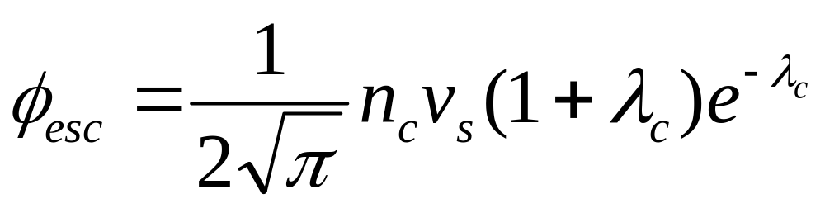
Jeans’ escape flux
The Jean’s escape velocity can be calculated by integrating
over the Maxwellian velocity distribution, taking into account
geometrical effects (escaping atoms must be headed upwards).
The result is
The escape flux is equal to the escape velocity times the
number density of hydrogen atoms at the critical level,
or exobase
φ_{esc} = n_{c}v_{J}

Slide 27
If the exospheric temperature is high, then Jeans’ escape is efficient and hydrogen is easily lost
  In this case, the rate of hydrogen escape is determined at the homopause (diffusion-limited flux)
If the exospheric temperature is low, then hydrogen escape may be bottled up at the exobase

Slide 28

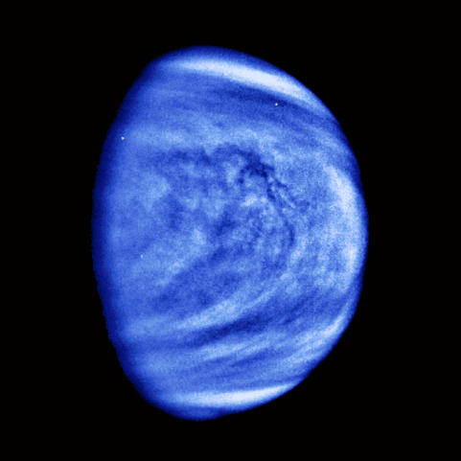
Hydrogen escape processes
Mars and Venus have CO₂-dominated upper atmospheres which are very cold (350-400 K)
⇒ Escape from the exobase is limiting on both planets

Slide 29
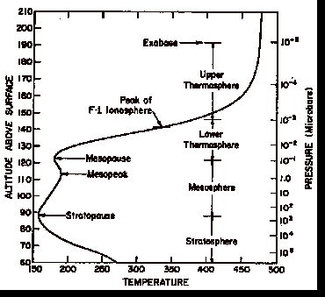
Venus dayside temperature profile
Upper atmosphere is relatively cool, despite being strongly heated by the Sun
CO₂ is a good infrared radiator, as well as absorber
http://www.atm.ox.ac.uk/user/fwt/WebPage
/Venus%20Review%204.htm

Slide 30
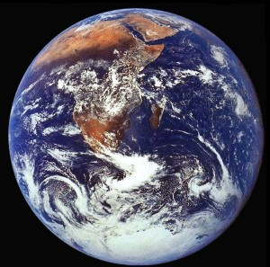
Hydrogen escape processes
For Earth, Jeans escape is efficient at solar maximum but not at solar minimum
  However, there are also other nonthermal H escape processes that can operate..

Slide 31
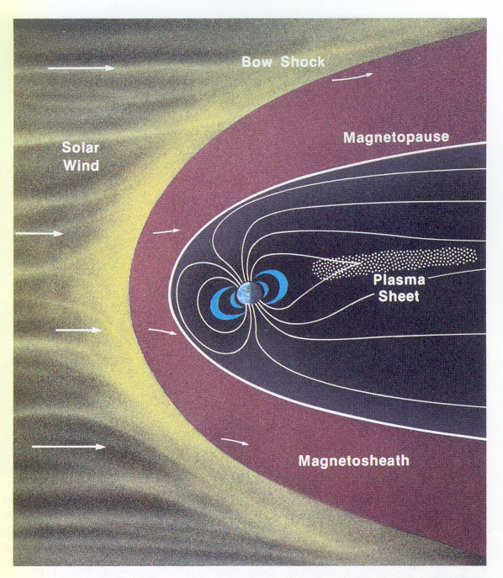
Nonthermal escape processes
Charge exchange with hot H⁺ ions from the magnetosphere
H + H⁺ (hot)
→ H⁺ + H (hot)
The New Solar System, ed., 3,
p. 35

Slide 32
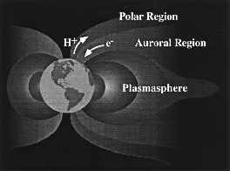
Nonthermal escape processes
The polar wind:
H⁺ ions can be accelerated out through open magnetic field lines in the polar regions
http://www.sprl.umich.edu/SPRL/research
/polar_wind.html

Slide 33
Conclusion: Hydrogen escape from present
Earth is limited by diffusion through the
homopause
Corollary: The escape rate is easy to
calculate

Slide 34
Diffusion-limited escape
On Earth, hydrogen escape is limited by diffusion through the homopause
Escape rate is given by (Walker, 1977)
  Φ_{esc}(H) ≅ b_{i} f_{tot}/H_{a}
  where
  b_{i} = binary diffusion parameter for H (or H₂) in air
  H_{a} = atmospheric (pressure) scale height
  f_{tot} = total hydrogen mixing ratio in the stratosphere

Slide 35
Numerically
  b_{i} ≅ 1.8×10¹⁹ cm⁻¹s⁻¹ (avg. of H and H₂ in air)
  H_{a} = kT/mg ≅ 6.4×10⁵ cm
so
Φ_{esc}(H) ≅ 2.5×10¹³ f_{tot}(H) (molecules cm⁻² s⁻¹)

Slide 36
Total hydrogen mixing ratio
In the stratosphere, hydrogen interconverts between various chemical forms
Rate of upward diffusion of hydrogen is determined by the total hydrogen mixing ratio
  f_{tot}(H) = f(H) + 2 f(H₂) + 2 f(H₂O) + 4 f(CH₄) + …
f_{tot}(H) is nearly constant from the tropopause up to the homopause (i.e., 10-100 km)

Slide 37
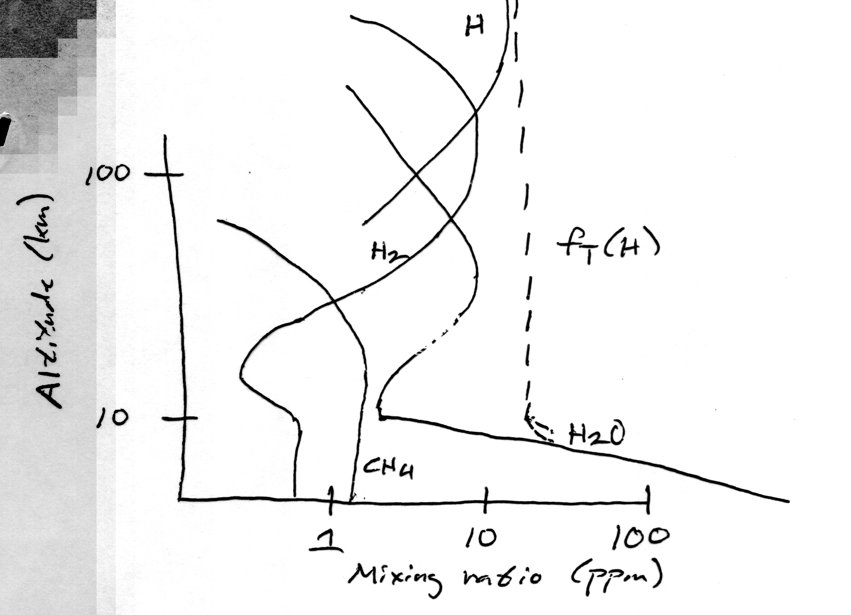
Total hydrogen mixing ratio
Homopause
Tropopause

Slide 38
Diffusion-limited escape
Let’s put in some numbers. In the lower stratosphere
  f(H₂O) ≅ 3-5 ppmv = (3-5)×10⁻⁶
  f(CH₄) = 1.6 ppmv = 1.6 ×10⁻⁶
Thus
  f_{tot}(H) = 2 (3×10⁻⁶) + 4 (1.6 ×10⁻⁶)
  ≅ 1.2×10⁻⁵
so the diffusion-limited escape rate is
Φ_{esc}(H) ≅ 2.5×10¹³ (1.2×10⁻⁵) = 3×10⁸ cm⁻² s⁻¹

Slide 39
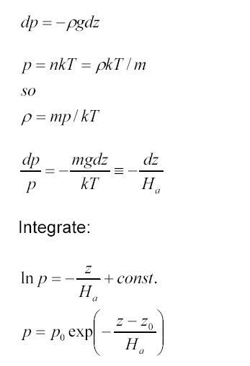
Breakdown of the barometric law
Normal barometric law
As z → ∞, p goes to zero, as expected

Slide 40
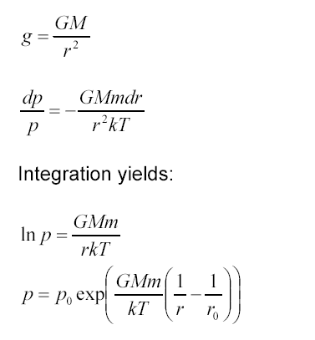
Breakdown of the barometric law
Now, allow g to vary with height
As r → ∞, p goes to a constant value
This suggests that the atmosphere has infinite mass!
How does one get out of this conundrum?

Slide 41
Answer(s):
Either
The atmosphere becomes collisionless at some height, so that pressure is not defined in the normal manner
  This is what happens in today’s atmosphere
or
The atmosphere is not hydrostatic, i.e., it must expand into space

Slide 42
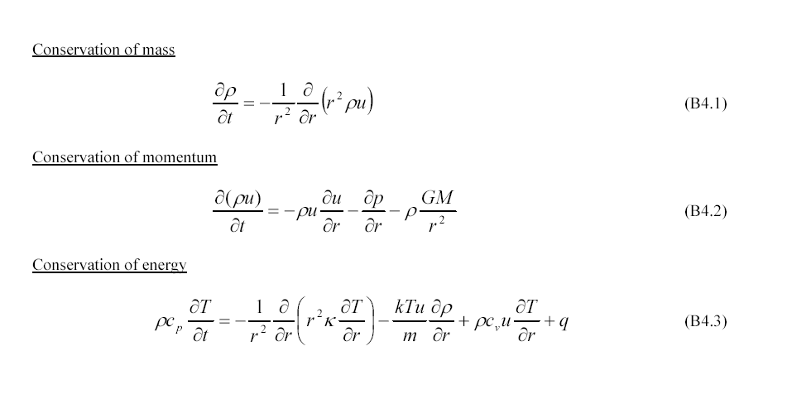
Fluid dynamical equations
(1-D, spherical coordinates)

Slide 43
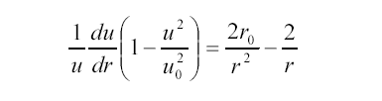
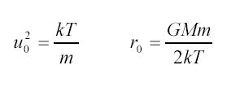
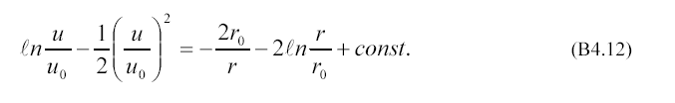
Bernoulli’s equation
If the energy equation is ignored, and we take
the solution to be isothermal (T = const.) and
time-independent, then the mass and momentum
equations can be combined to yield Bernoulli’s
equation
This equation can be integrated to give

Slide 44
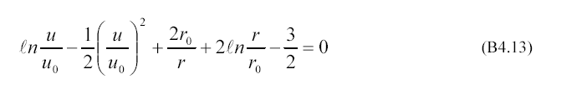
Transonic solution
Bernoulli’s equation give rise to a whole family
of mathematical solutions
One of these is the transonic solution
This solution goes through the critical point
(r₀, u₀), where both sides of the differential
form of the equation vanish

Slide 45
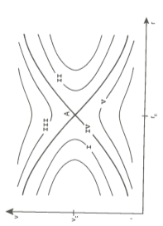
5 Classes of solution.
Classes I and II are double-valued (not physically meaningful).
Class III begins super-sonically.
  Also not useful.
Class V is sub-sonic
  The “breeze case”
Class IV begins sub-sonically for r < r₀ and transitions to super-sonic at the critical point.
From Gombosi, 1999

Slide 46
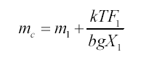
Mass fractionation during hydrodynamic escape
Hydrodynamic escape of hydrogen can fractionate elements and isotopes by carrying off heavier gases
This becomes important for gases lighter than the crossover mass
m₁ = mass of hydrogen atom (or molecule)
F₁ = escape flux of hydrogen
X₁ = mixing ratio of hydrogen
b = binary diffusion coefficient (= D_{i} /n)

Slide 47

Energy-limited escape
The energy needed to power hydrodynamic escape is provided by absorption of solar EUV radiation (λ < 900 nm)
  The solar flux at these wavelengths is ~1 erg/cm²/s
The energy-limited escape rate, Φ_{EL} is given by
S = solar EUV flux
ε = EUV heating efficiency (typically 0.15-0.3)

Slide 48
Hydrogen escape: summary
Hydrogen escapes from terrestrial planets by a variety of thermal and nonthermal mechanisms
H escape can be limited either at the homopause (by diffusion) or at the exobase (by energy)
Hydrogen can drag off heavier elements as it escapes, provided that the escape flux is fast enough

